Slide 1
Keypad Password-secured Toggle of Port B
TEAM 10
مصطفى السيد محمد رضا محمد أبو النجا
مصطفى محمد رجـب محمد عبــد اللطيف
معـاذ أحمـد عبـد الــسلام إبراهيـم قاسـم
محمـــــــود إبراهيــــــــم منيــــــــــر عفيــــفي
يوســــــف سميــــــــر حســــــــن سويـــــــــلـم
روان علـــــوي عــــلي حـــامـــد حــــسيــــــــــن

Slide 2
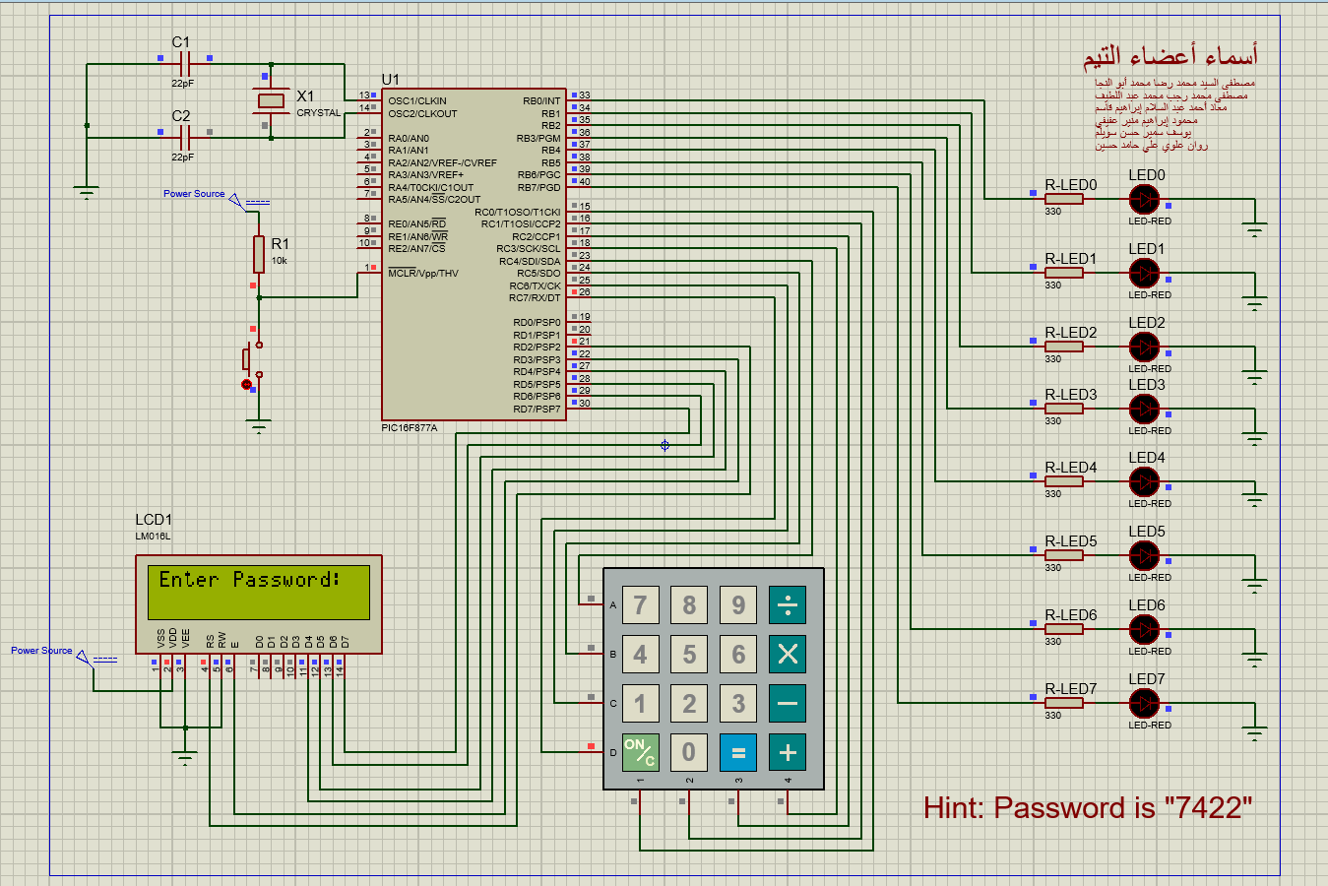
Overview
The main idea is to secure lighting action/performance implemented by the Port B.
This is done using the keypad to enter a password and an LCD to show the status of the overall system, and of course the microcontroller PIC16F877A to control everything.
In this figure, we are starting the simulation where we are asked to enter a password to start toggling the light.

Slide 3
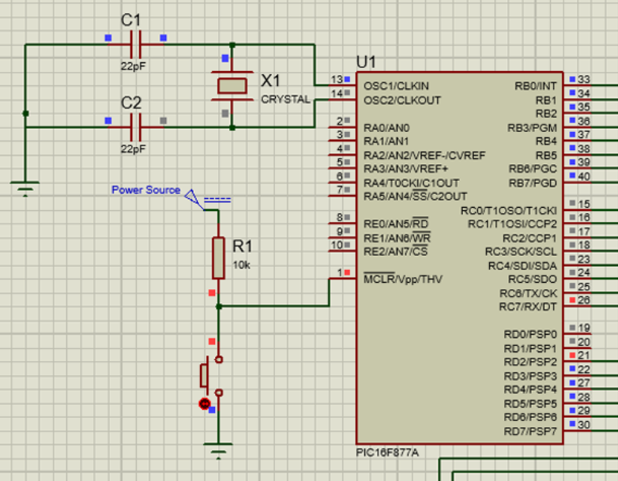
In-depth with each component
PIC 16F877A – Micro-controller
Here, we set up the micro-controller with a classic configuration, where we connect a crystal as a clock for our system, a power source to supply the power to the micro-controller, and we simply connect the keypad, the LEDs, and the LCD using ports D, B, and C, respectively.

Slide 4
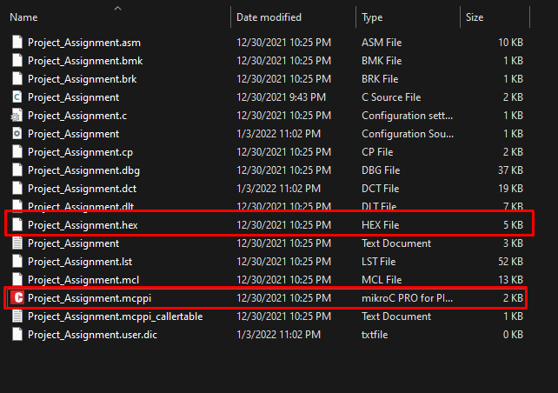
In-depth with each component
PIC 16F877A – Micro-controller
We then run a .hex code file that implements the whole functionality of our application/system. The .hex file is the compiled version of this C code written in mikroC, shown in the next few slides.

Slide 5
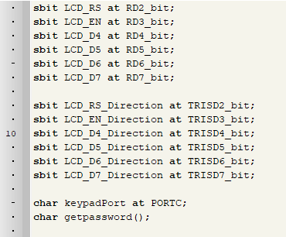
In-depth with each component
PIC 16F877A – Micro-controller
Here, we just declare the port labels to be used in the LCD, by defining a name and the direction, etc.
We also declare the port that would be used in the keypad, and a prototype for a function to be used to check the passwords that are typed into the keypad.

Slide 6
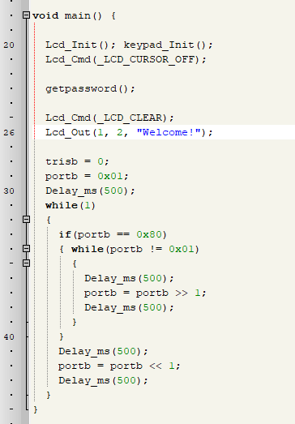
In-depth with each component
PIC 16F877A – Micro-controller
We then declare our main function, to kick off with everything required, initializing the LCD and the keypad.
By default, we try to get the user to input the password in order to continue with the program, which is simply welcoming the user with a “Welcome!” message, displayed in the LCD, and the toggle of some LEDs connected via Port B.

Slide 7
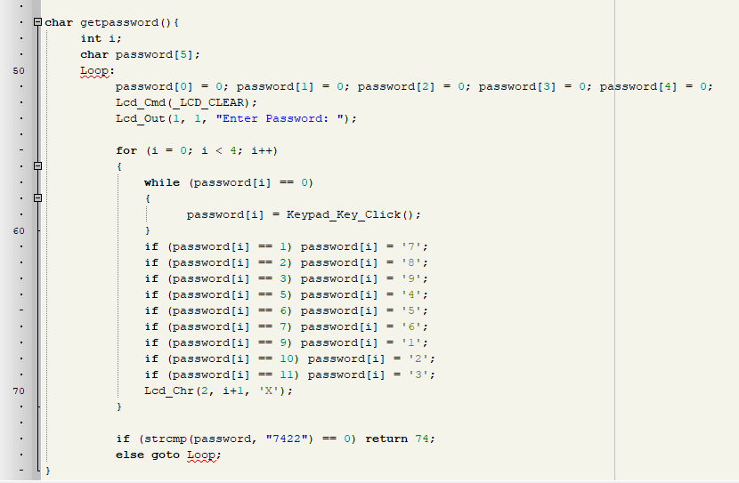
In-depth with each component
PIC 16F877A – Micro-controller
Lastly, the definition of our previously prototyped function, where we get the input from the user (the password), then we try to match it with some saved password (hard-coded in our case as 7422), if it matches, we return, if not we stay in this function trying once more for another password input try.

Slide 8
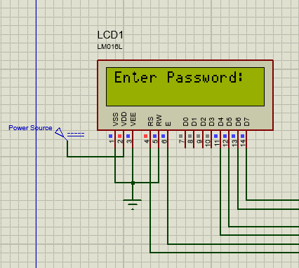
In-depth with each component
LM016L - LCD
We also set up the LCD with some classic connections. We provide a power source for this component by itself, and we connect the last 4 pins of the data port (D4 – D7).
We start off displaying the “Enter Password:” message, to ask the user to interact with the keypad.
While the user types a number, it gets displayed encrypted as X in the LCD. Also, we end up with a “Welcome!” message if he enters the right password.

Slide 9
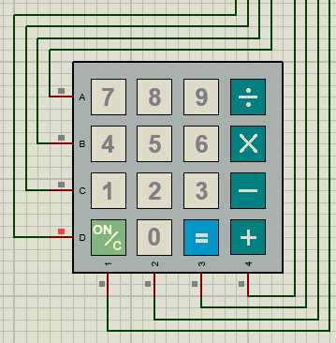
In-depth with each component
KEYPADSMALLCALC - Keypad
We configure everything as per usual, and we let the mikroC library of keypads do the work.
The user gets to input the password using this keypad.

Slide 10
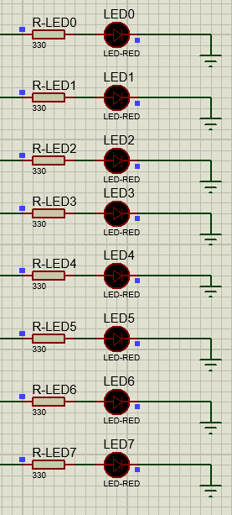
In-depth with each component
LED-RED - LEDs
Lastly, we put down some LEDs as shown, connected with a resistor of 330 ohms, just to protect the LEDs from excessive current, etc.

Slide 11
How does it work?
At first, we run the system/application, we see that we need to enter a password (this is displayed in the LCD).
Then, the user simply needs to enter the right password in order to make everything run. In our case we hard coded the password as “7422”.
So, the user needs to input 7 > 4 > 2 > 2 using the keypad in order to pass this stage.
If it’s the right password, we are then welcomed with the “Welcome!” message displayed on the LCD, and everything starts to run!
The LEDs now toggle one by one, and it goes back and forth, just making some artistically-okay motion/action, indicating that everything works, just fine.

Slide 12
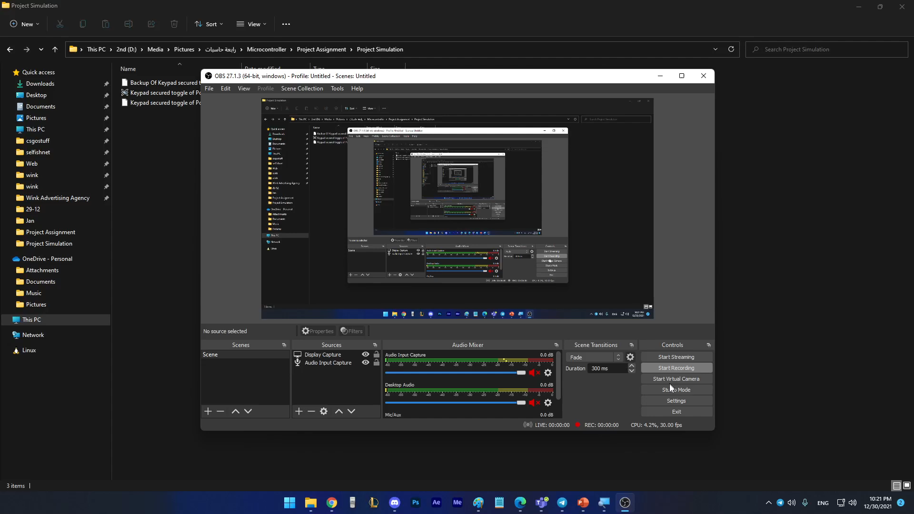
How does it work?
Preview
Here’s a video-preview that shows around the simulation of our system/application at hand.

Slide 13
THANKS!

